Slide 1







Business Analytics: Applications, Impact & Competitive Advantage
David Weltman
Business Analytics
Fall 2024

Slide 2









Topics
Overview
AI
What is Business Analytics
Big Data
Platforms
Example Applications
A Few Popular/Top BA Methodologies
Regression Analysis, Predict Amount
Trees, Predict Class (classifiers)
Monte Carlo Simulation, Predict Amounts (forecasting)
Cluster Analysis, Form Groups
Quiz

Slide 3




Review Quiz!
www.kahoot.it, 12 questions
x

Slide 4




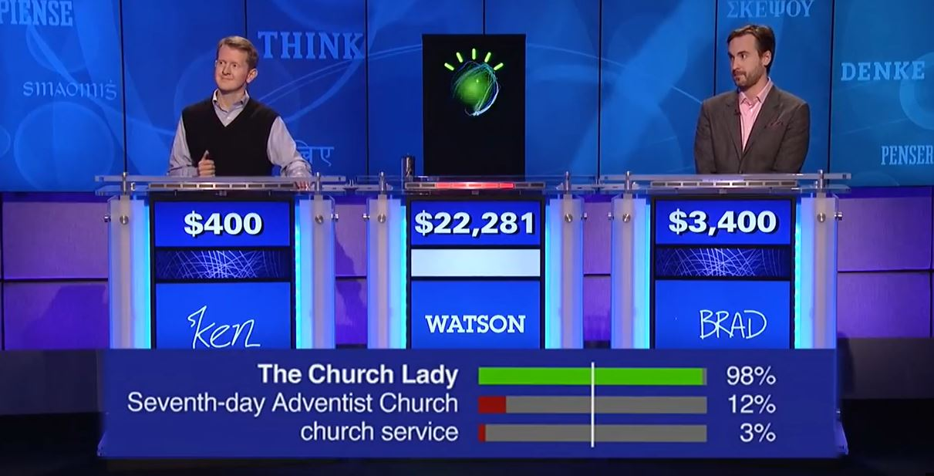
AI

Slide 5




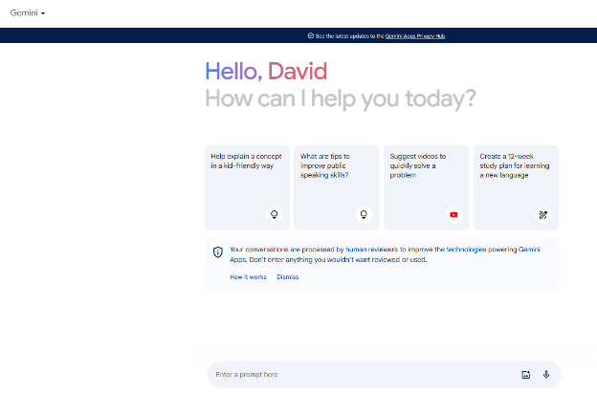

AI

Slide 6


Areas of Business Analytics
Descriptive and Diagnostic Analytics
Predictive and Prescriptive Analytics

Slide 7
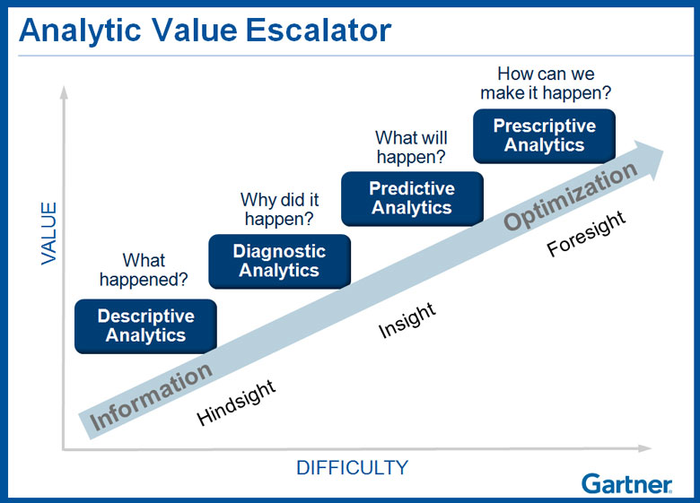
Areas of Business Analytics

Slide 8




Business Analytics Course
Descriptive and Diagnostic Analytics
Predictive and Prescriptive Analytics
The Field of Business Analytics
Common Business Analytic and Statistical Metrics
Probability
Visualizations
Dashboards
Decision / Classification Trees
Cluster Analysis
Market Basket Analysis
Neural Networks
Monte Carlo Simulation
Regression / Forecasting

Slide 9



Business Analytics Course

Slide 10
Business Analytics Course

Slide 11
Business Analytics Course

Slide 12
Business Analytics Course

Slide 13
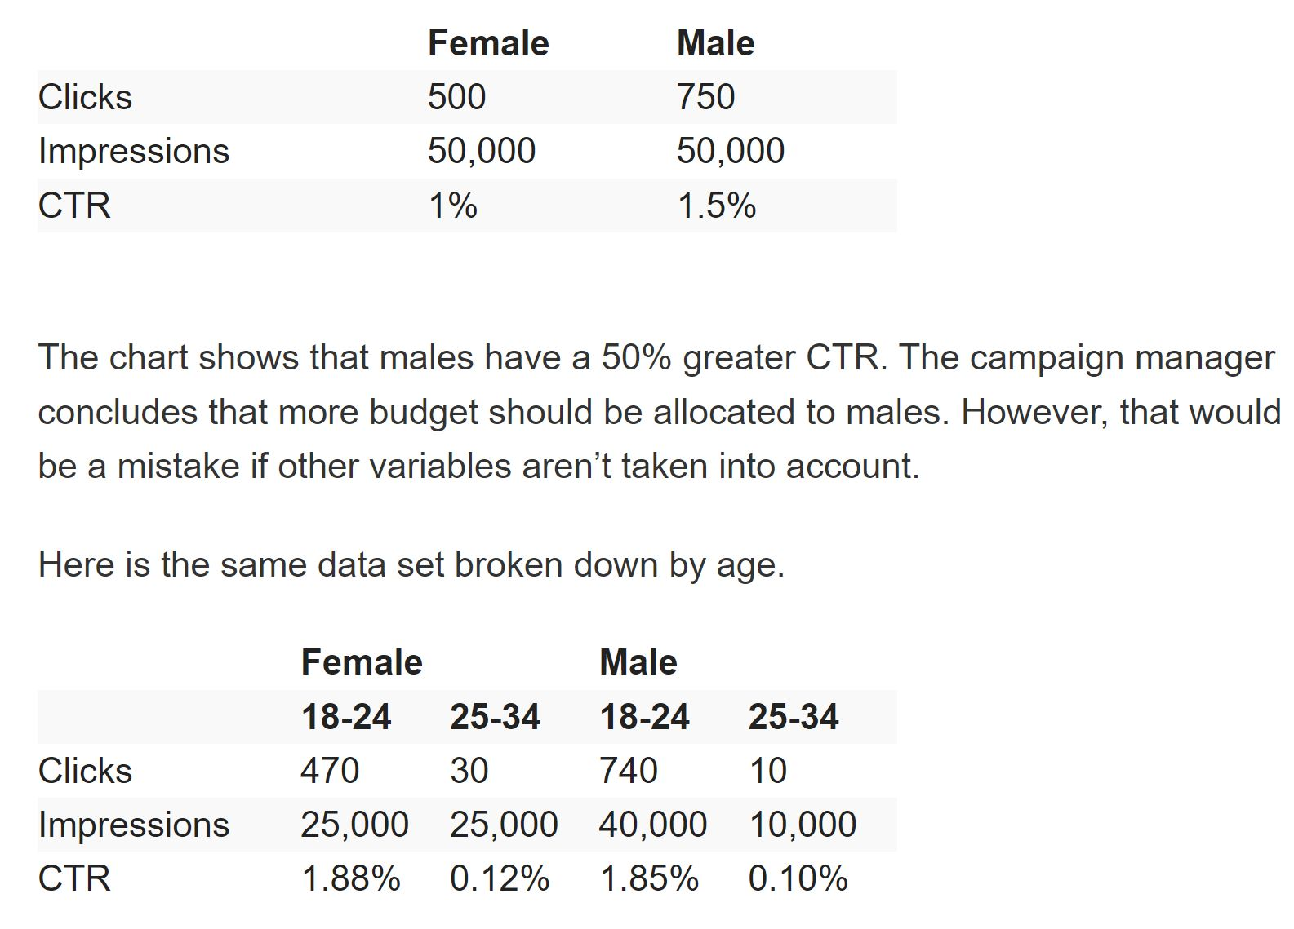

Business Analytics Course
www.adexchanger.com

Slide 14
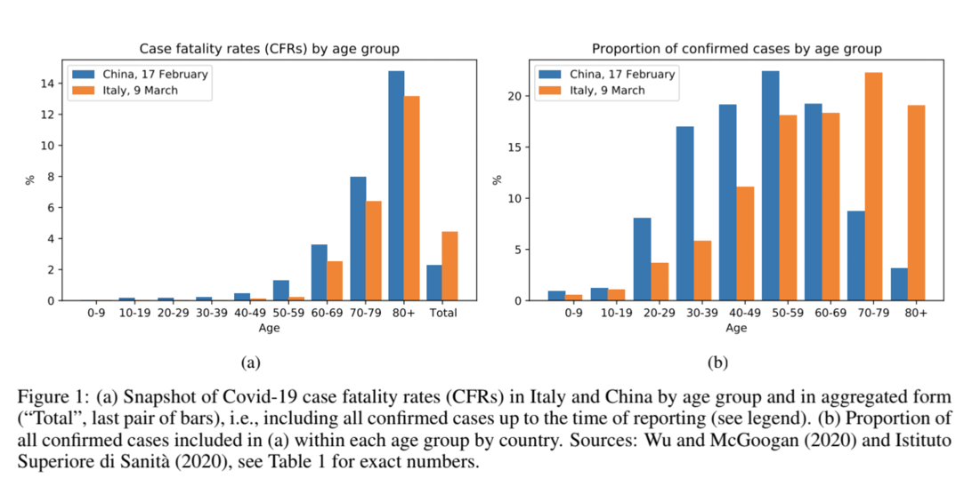
Business Analytics Course

Slide 15
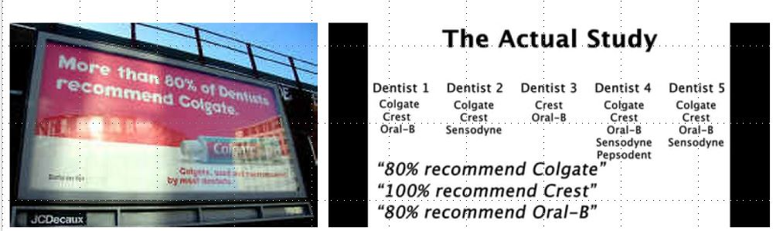
Business Analytics Course

Slide 16
Business Analytics Course

Slide 17
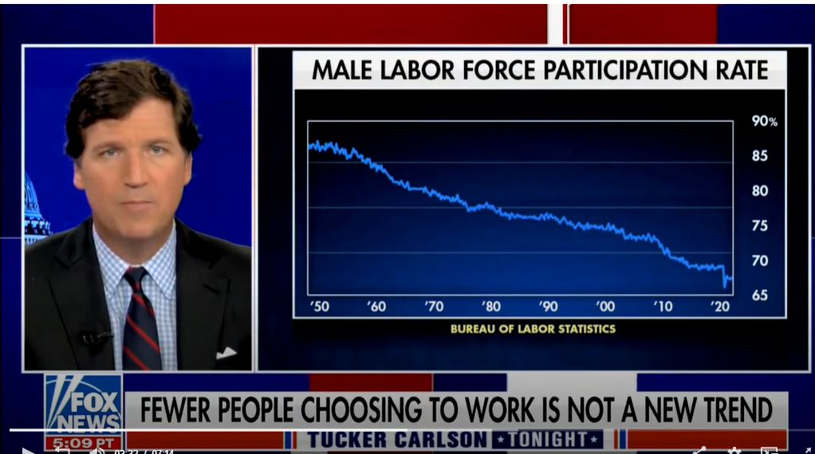
Business Analytics Course
12/16/2021 air date, Fox News

Slide 18
Business Analytics Course
Male Labor Force Participation Rate
U.S. Bureau of Labor Statistics
www.bls.gov

Slide 19
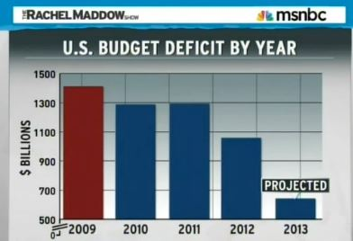

Business Analytics Course

Slide 20















Some Popular Platforms for Business Analytics
Descriptive and Diagnostic Analytics
Predictive and Prescriptive Analytics

Slide 21
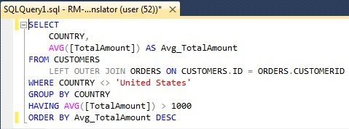
Techniques of Business Analytics
Traditional Query Platforms and/or Programming
Machine Learning

Slide 22
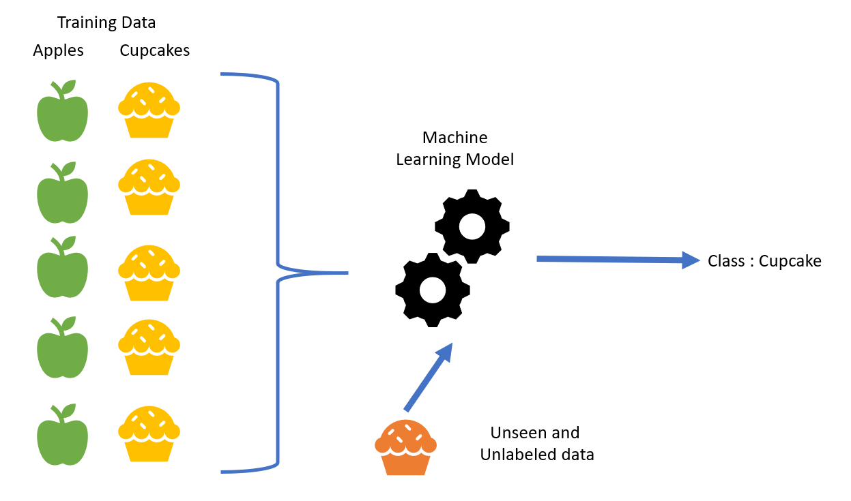
Machine Learning
Supervised Machine Learning

Slide 23

Machine Learning
Uses techniques and methods in AI and Machine Learning.
Probability
Randomness
Uncertainty

Slide 24




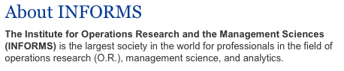
Business Analytics
Accessible Software
Powerful Computing Power
Data
The process of transforming data into insight for making better decisions. (INFORMS)

Slide 25


The Fuel for Business Analytics
V’s

Slide 26
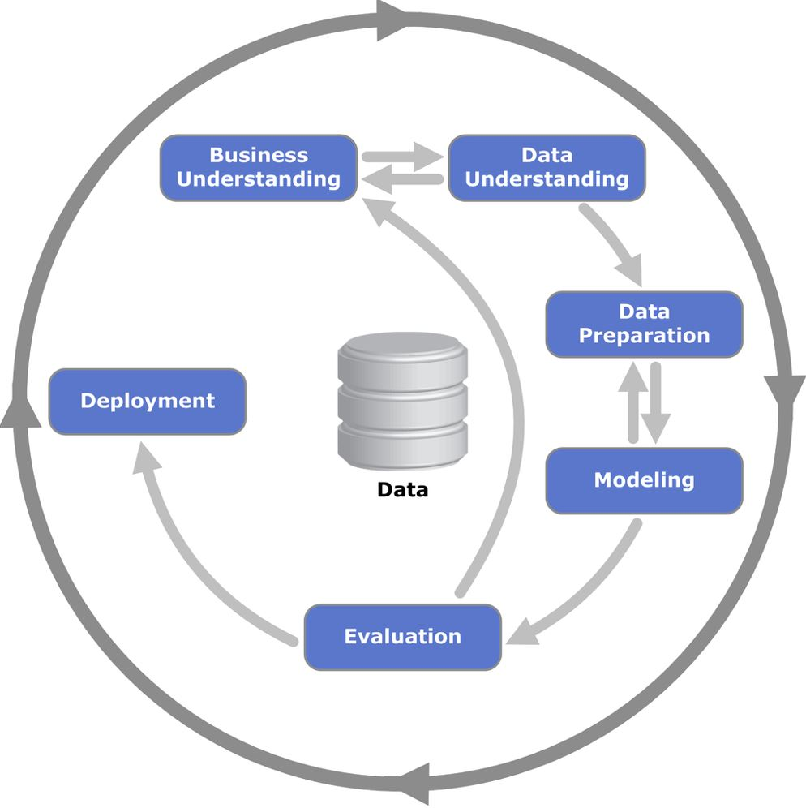
Process Guiding Framework
CRISP-DM, Cross-Industry Standard Process for Data Mining

Slide 27
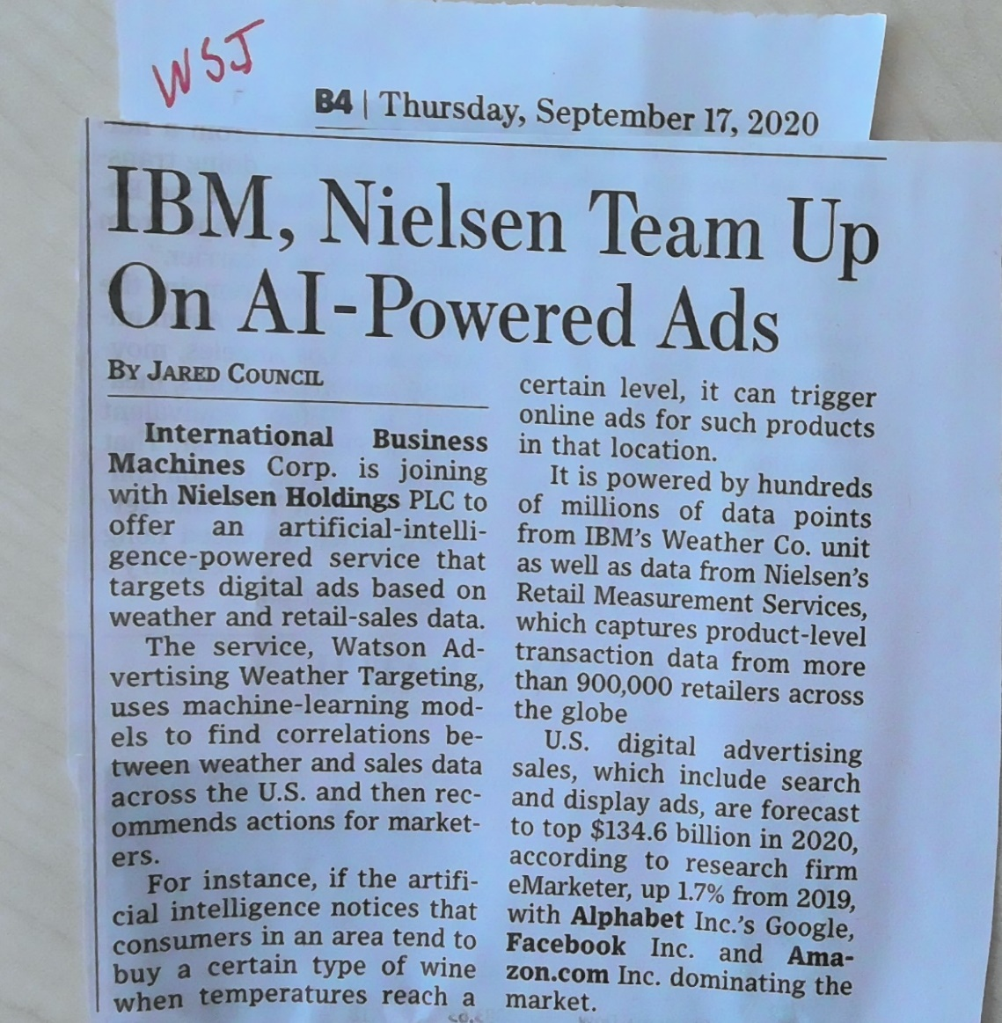
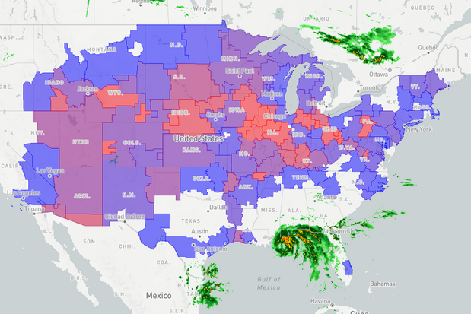
Example Applications

Slide 28


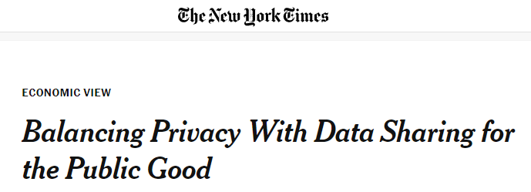
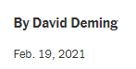

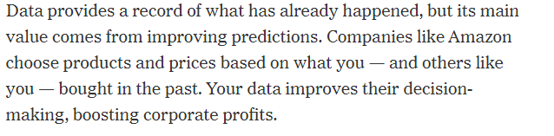
Value of Data

Slide 29





















Target
Teletrack

Slide 30

Walmart
“The mother of all supply chain analytics competitors is Walmart”
Davenport 2007, Competing on Analytics, Harvard Business Review Press
Tailored product mix.
Store layouts.
Move products efficiently.
Inventory decisions.
http://www.countryliving.com/food-drinks/a44550/walmart-strawberry-pop-tarts-before-hurricane/
August 25th, 2017

Slide 31

Progressive

Slide 32

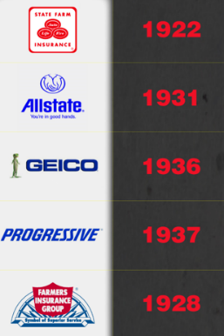
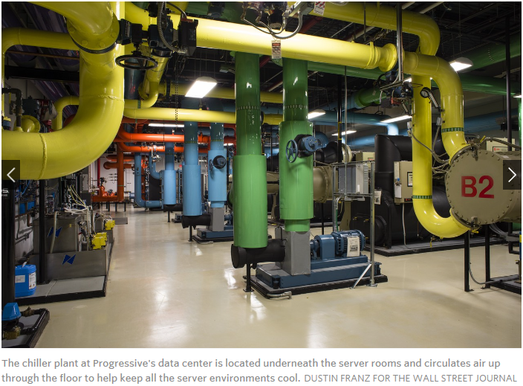

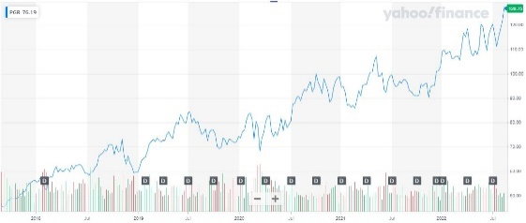
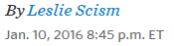

Progressive

Slide 33


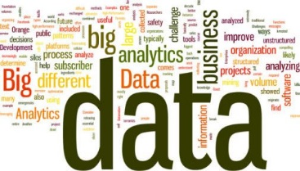
Google
Do Managers Matter?
“They used regression analysis to determine whether managers who scored high semi-annual performance evaluations had subordinate engineers who also scored highly on performance and retention. The answer was that they did.”
Is a good coach
Empowers the team and does not micromanage
Expresses interest / concern for team members’ success and personal wellbeing
Is productive and results-orientated
Is a good communicator – listens and shares information
Helps with career development
Has a clear vision / strategy for the team
Has important technical skills that help him / her advice the team
10,000+ observations, 100+ variables
Performance appraisals, employee surveys
Top manager award nominations
Multi-year
Top down, bottom up
Qualitative & quantitative
https://wol.iza.org/articles/bosses-matter-the-effects-of-managers-on-workers-performance/long

Slide 34

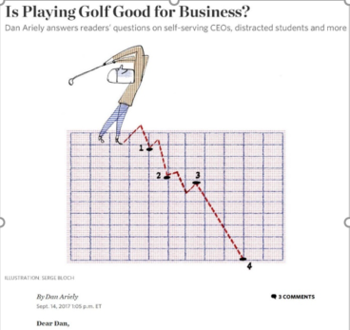
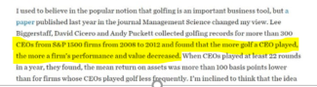
CEO Golf
https://wol.iza.org/articles/bosses-matter-the-effects-of-managers-on-workers-performance/long

Slide 35
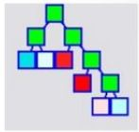





Classification Trees
Did your wife see you?
YES
NO
Was it expensive?
Eat It
YES
NO
Can you cut off the part that touched the floor?
Is it bacon?
YES
NO
YES
NO
Eat It
Eat It
Don’t Eat It
Eat It

Slide 36



Classification Trees
amount/balance outstanding
number of payments made
term
credit score change
marital status
change
http://docs.salford-systems.com/MoazamiLi.pdf

Slide 37
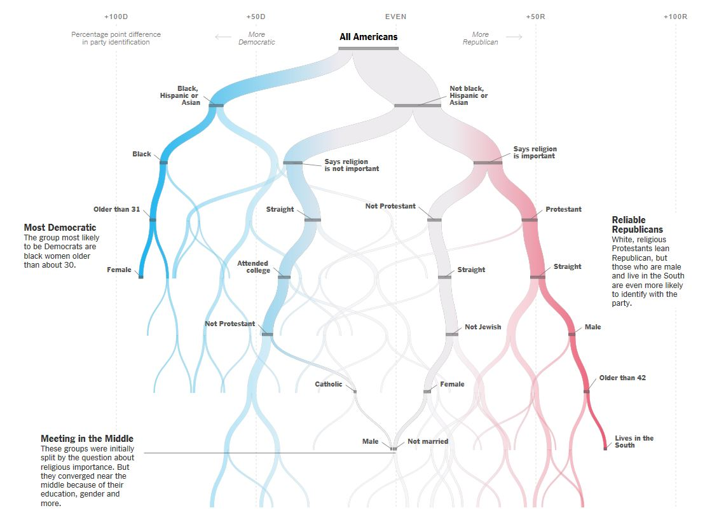
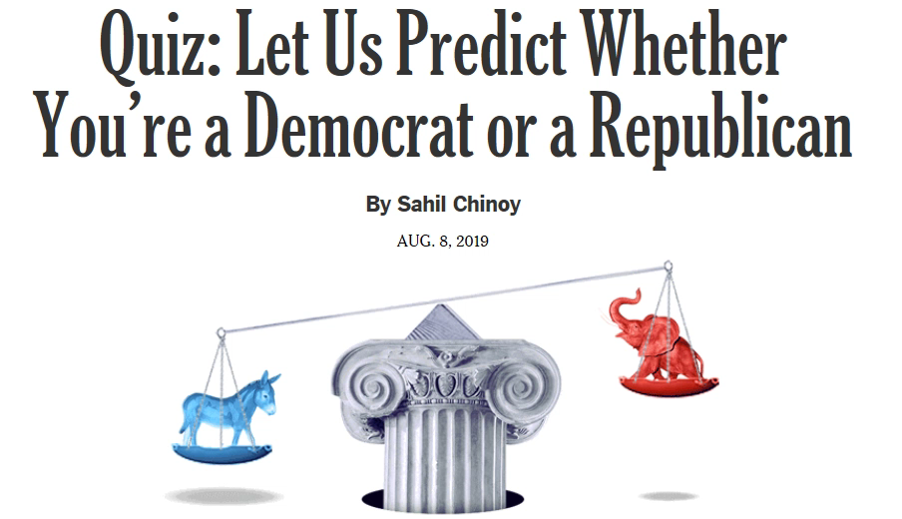

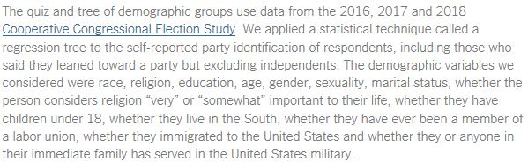
Classification Trees

Slide 38

Classification Trees
Labeled historical data that we want to leverage to make predictions regarding future shipment timeliness.
Two features/predictors and one labeled target for simplicity.

Slide 39
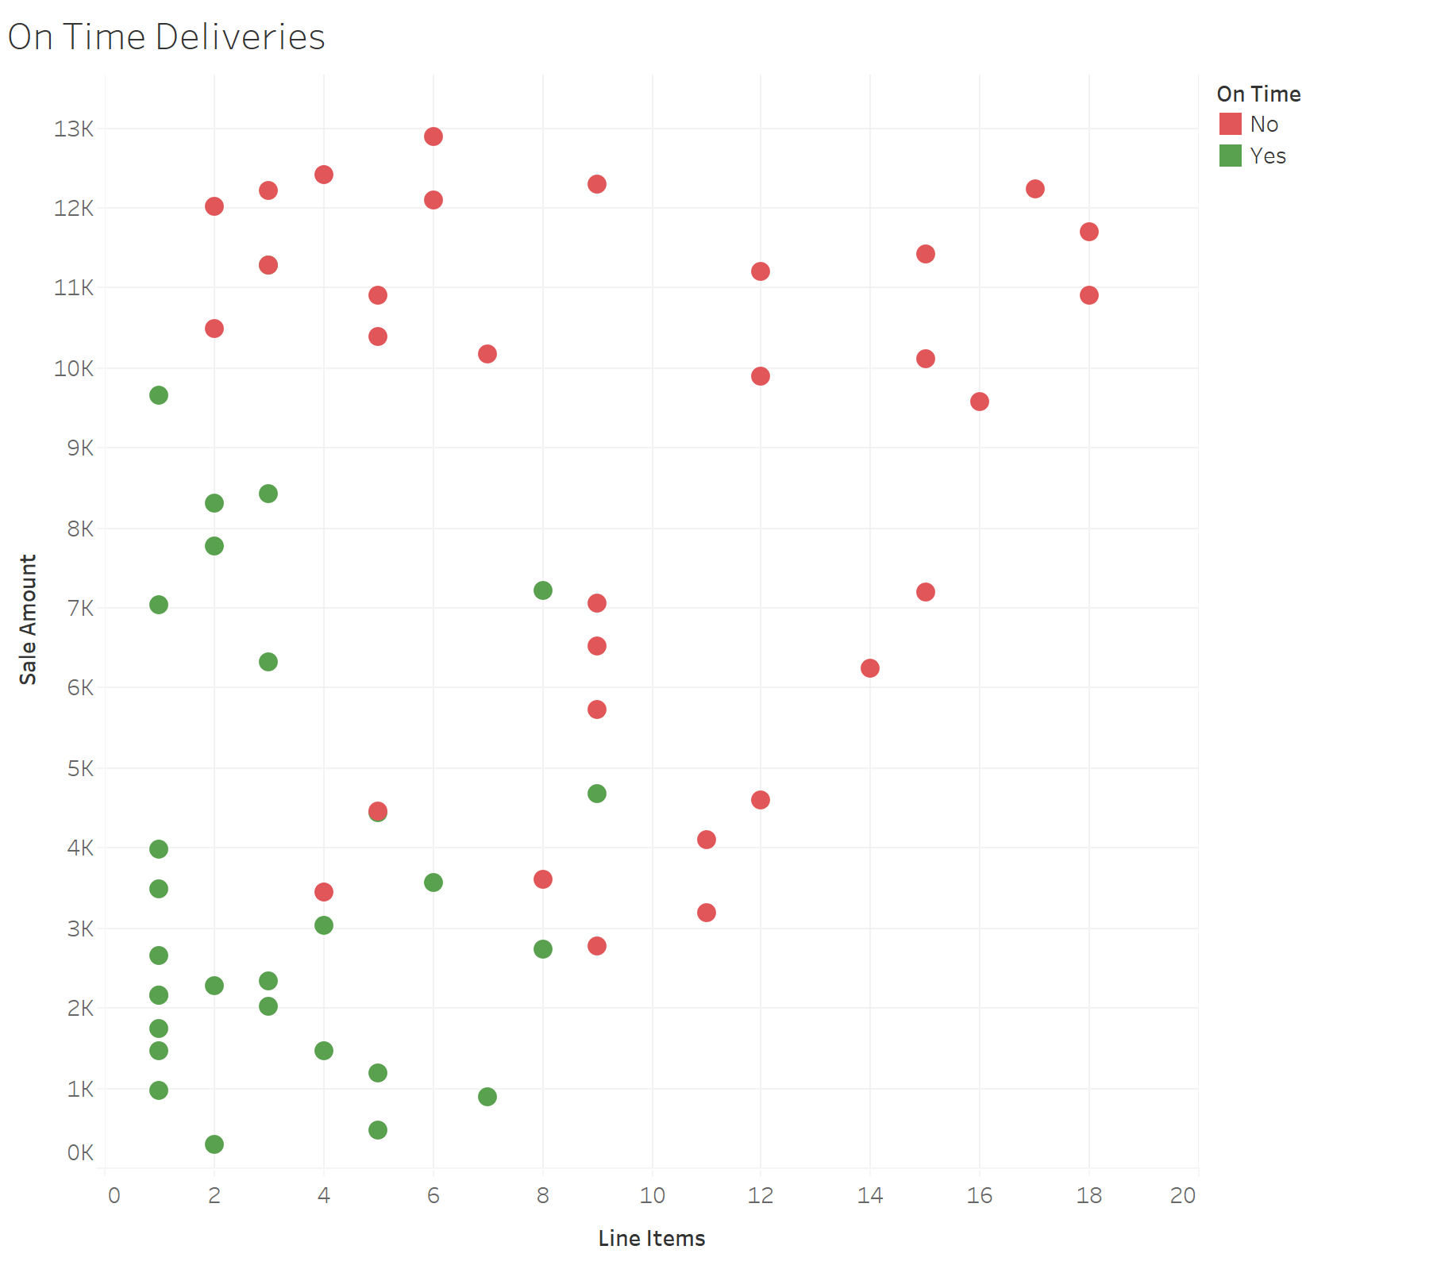
Classification Trees
The feature space, the n-dimensional space where your variables “live”.

Slide 40
Classification Trees
The feature space, the n-dimensional space where your variables “live”.

Slide 41
Classification Trees
The feature space, the n-dimensional space where your variables “live”.

Slide 42
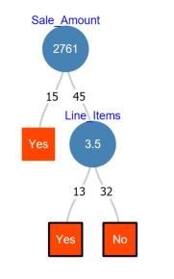
Classification Trees
>
<
>
<

Slide 43

Workflow
Data Set
Standard Data Partition
Split Data
Training data set
Validation data set
Model Build
Evaluate Model
Deploy Model
Make Predictions

Slide 44
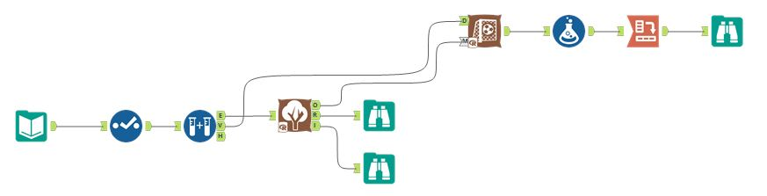
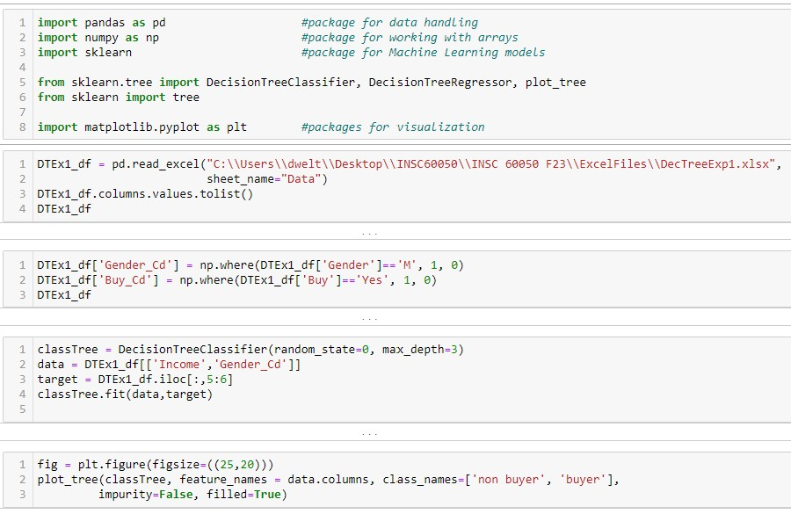
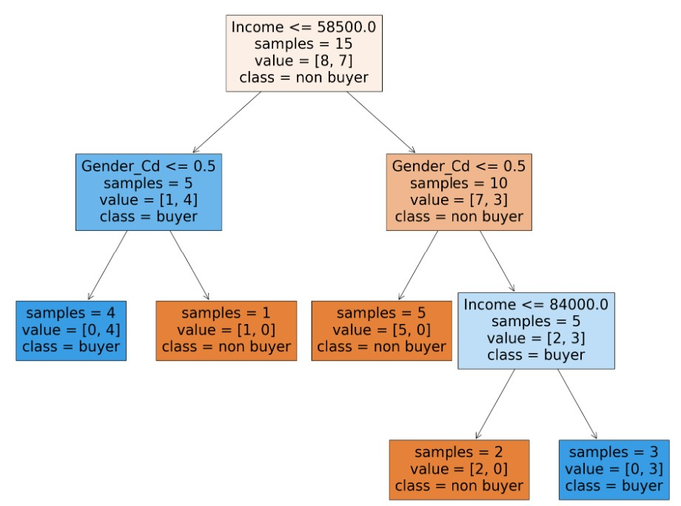

Workflow

Slide 45


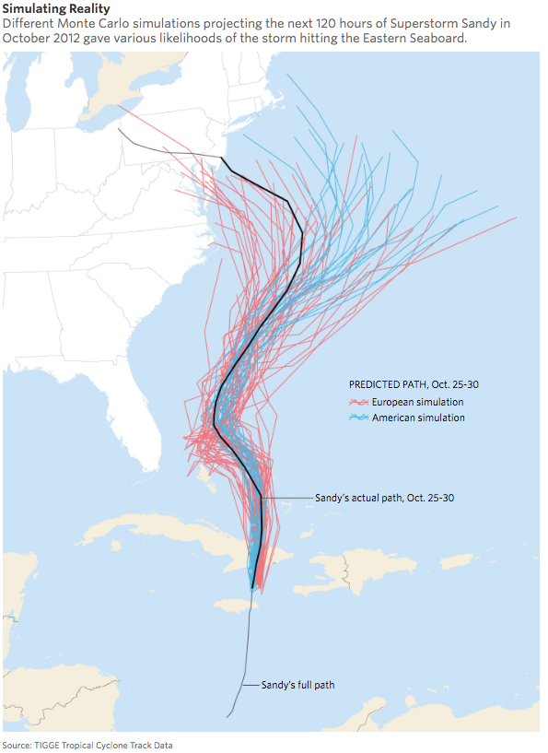
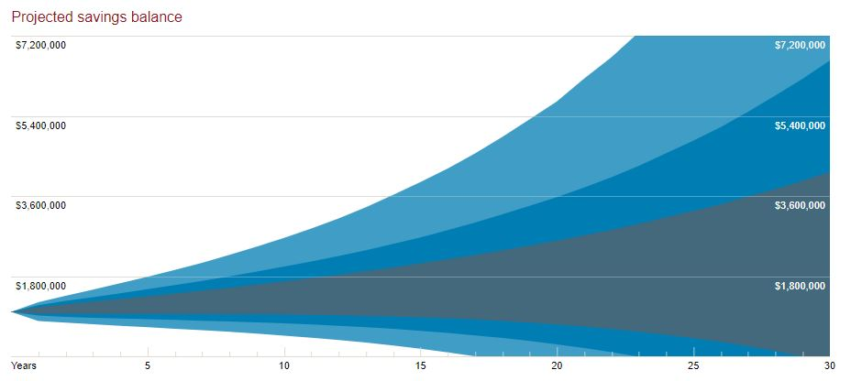
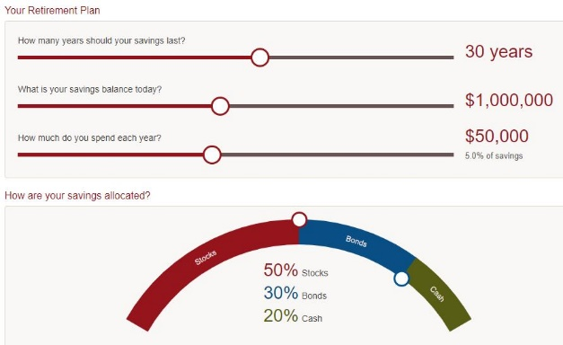
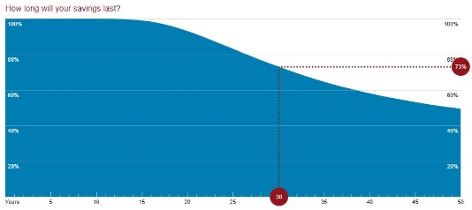


Monte Carlo Methods
“Monte Carlo simulations are a way of addressing any number of complex problems that can’t be easily solved with an equation.”

Slide 46

Monte Carlo Analysis
A distribution organization is interested in analyzing potential profit possibilities for a new product they will soon be offering to their customers next month.
What are the potential profit possibilities for this new product?
Which of the uncertain factors (price, demand, cost) is most impactful to the bottom line? Best course of action to take?

Slide 47
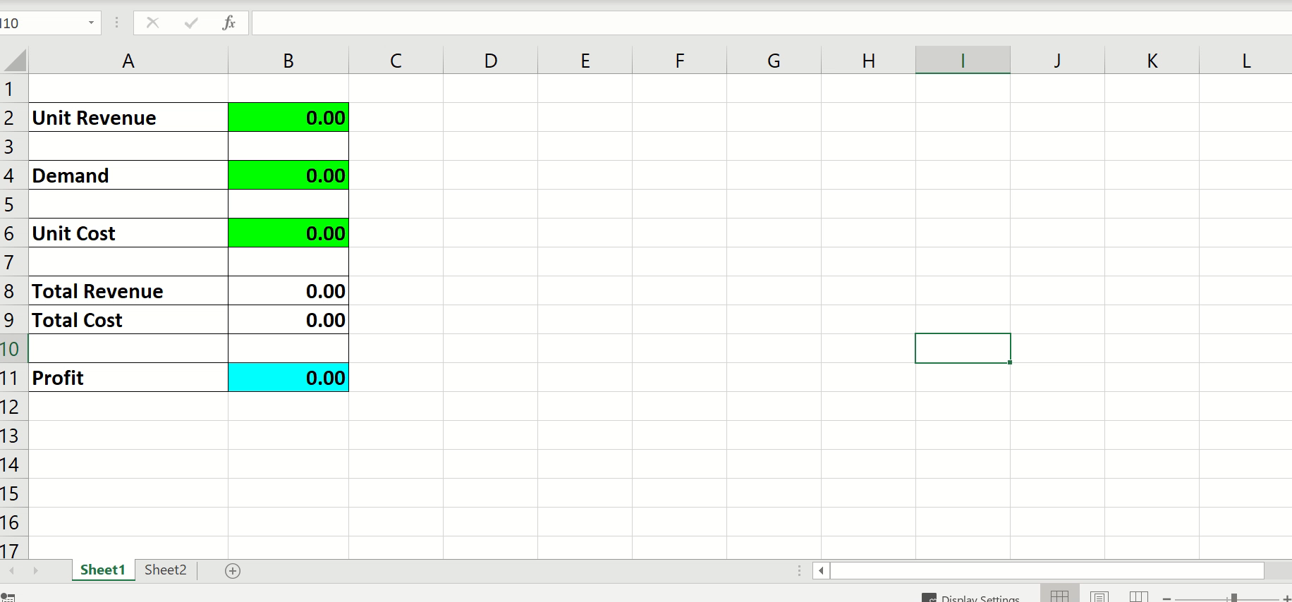
Monte Carlo Analysis
Weltman August 2019, Tableau 2019.2

Slide 48
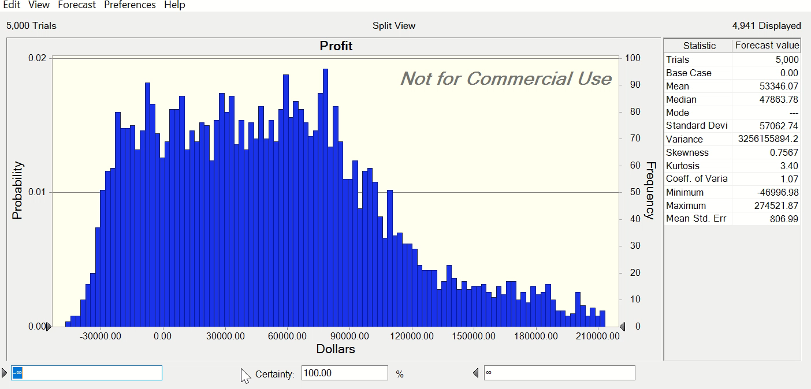
Monte Carlo Analysis
Weltman August 2019, Tableau 2019.2

Slide 49
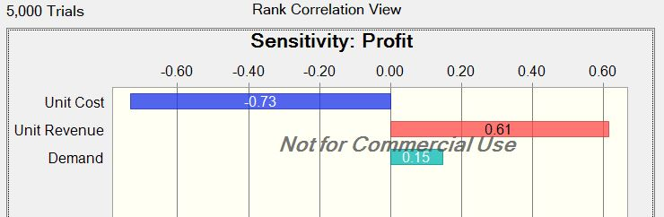
Monte Carlo Analysis
Weltman August 2019, Tableau 2019.2

Slide 50


Cluster Analysis
Unsupervised Machine Learning

Slide 51
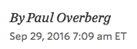
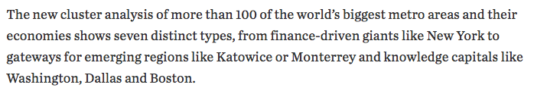

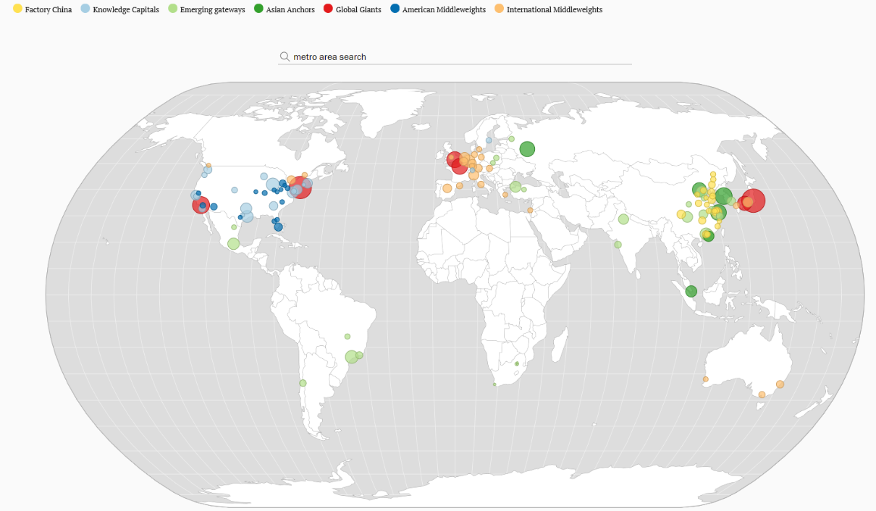

Cluster Analysis

Slide 52
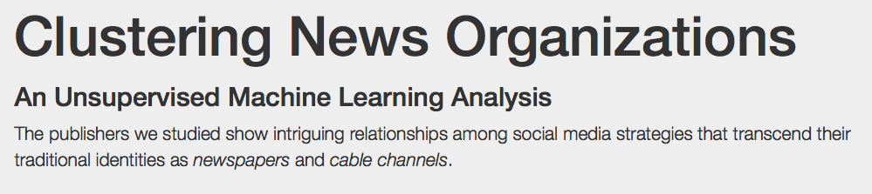
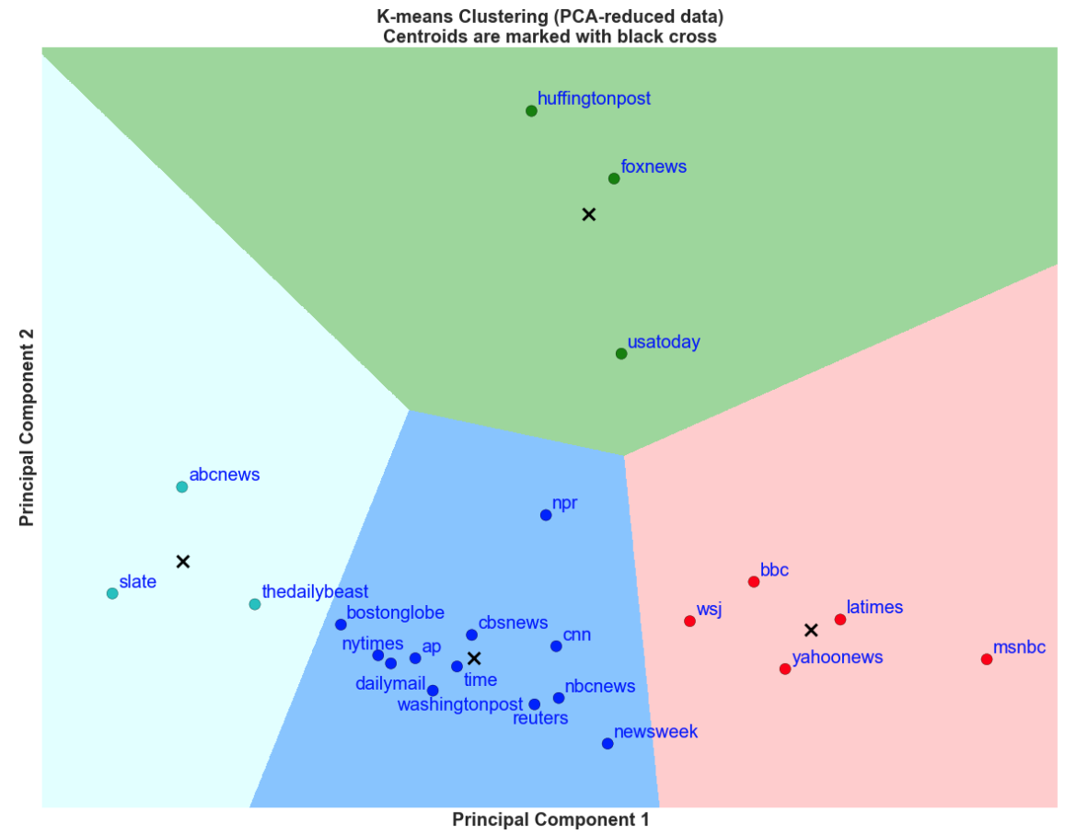
Cluster Analysis
http://social-news.github.io/clustering.htm

Slide 53
Cluster Analysis
We are constantly redeploying our support resources without any strategy or direction. Our support department has grown overall and is over budget. We don’t know if this growth is useful. Customer complaints are increasing, overall.
Revenues have been increasing, yet profitability has been flat.
Marketing feels it does not understand the customer base and where to allocate resource. Which customers should be handled with special care for instance? Which customers should receive more support? Are we spending too much time with some customers?

Slide 54
Cluster Analysis

Slide 55
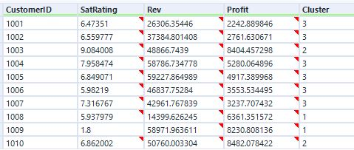
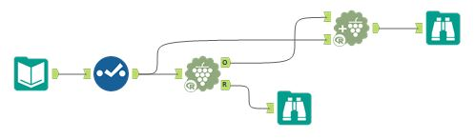
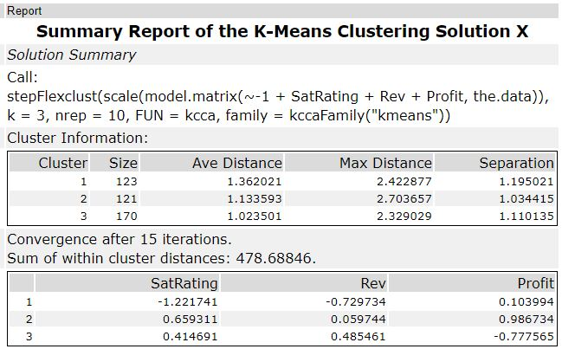
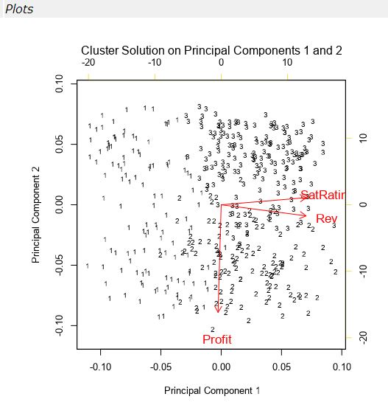
Cluster Analysis

Slide 56
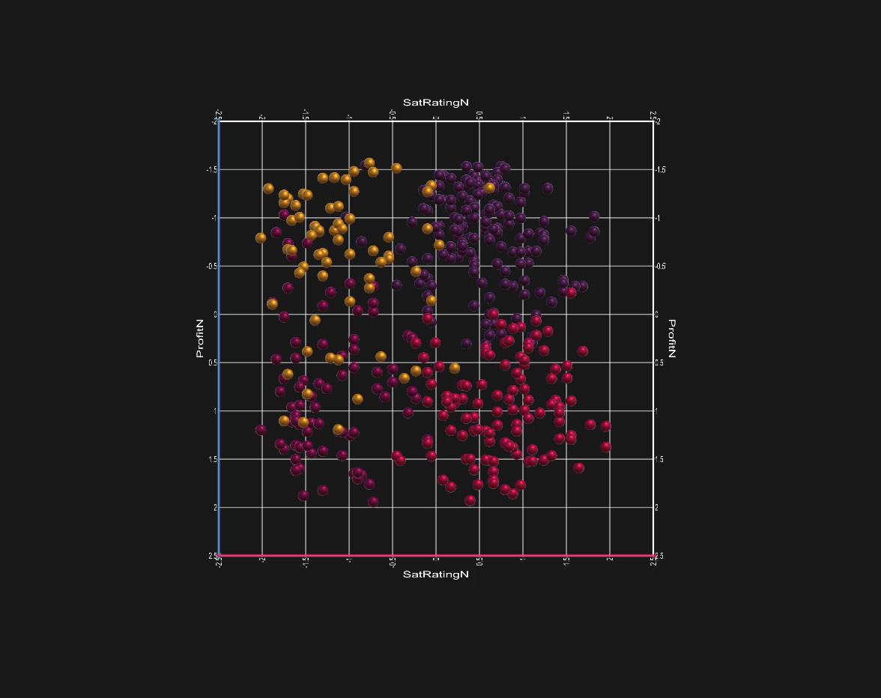


Cluster Analysis
Weltman August 2019, Microsoft Charts 3D

Slide 57

Review Quiz
Review Quiz, www.kahoot.it, 12 questions
12 Questions

